Slide 1


E-COMMERCE MOBILE PHONE MARKET ANALYSIS
Ajay
Presented By :

Slide 2

Introduction :
This project executes a full data pipeline, starting with Web Scraping 1,161 mobile phone records, followed by EDA and Cleaning to build a Price Prediction Model optimized through Hyperparameter Tuning.

Slide 3
Project Flow :
Phase 1:
Phase 2:
Data Scrapping & csv
Data cleaning &Analysis
Phase 3 :
Phase 4 :
Un Supervised & Supervised learning
Hyperparameter Tuning

Slide 4
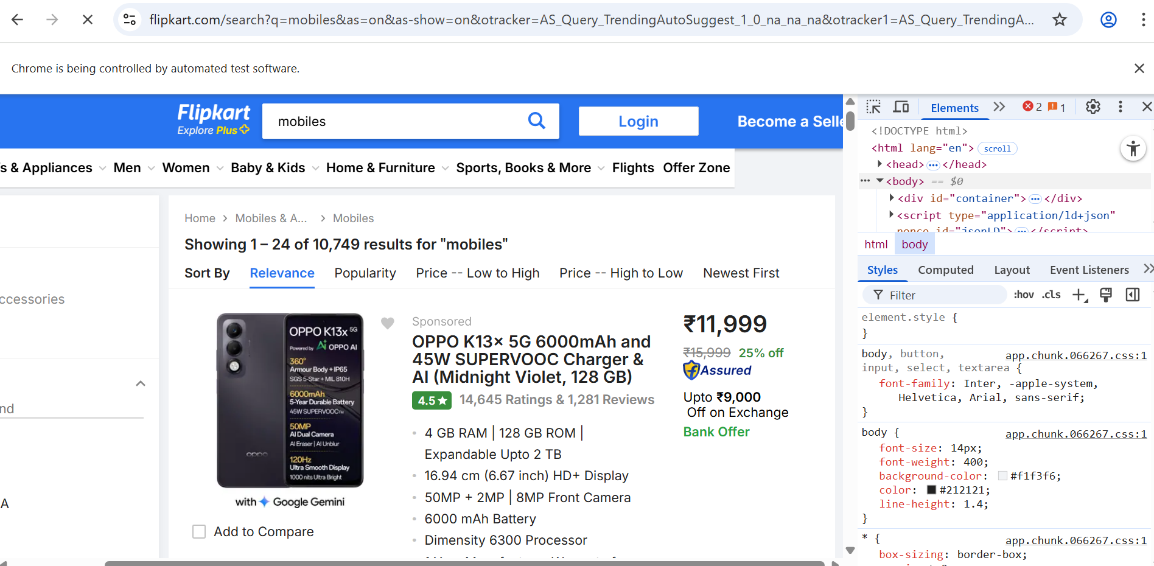
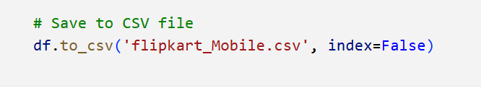
Web Scrapping :
Tools: Selenium (For Browser Automation) And Beautifulsoup (For HTML Parsing).
Action: Extracted Price, Rating, Title, And Review Count From The Flipkart Page.
Result: Exactly Scrap 40 Pages & Secured 1,161 Initial Product Records, Forming The Raw Dataset

Slide 5
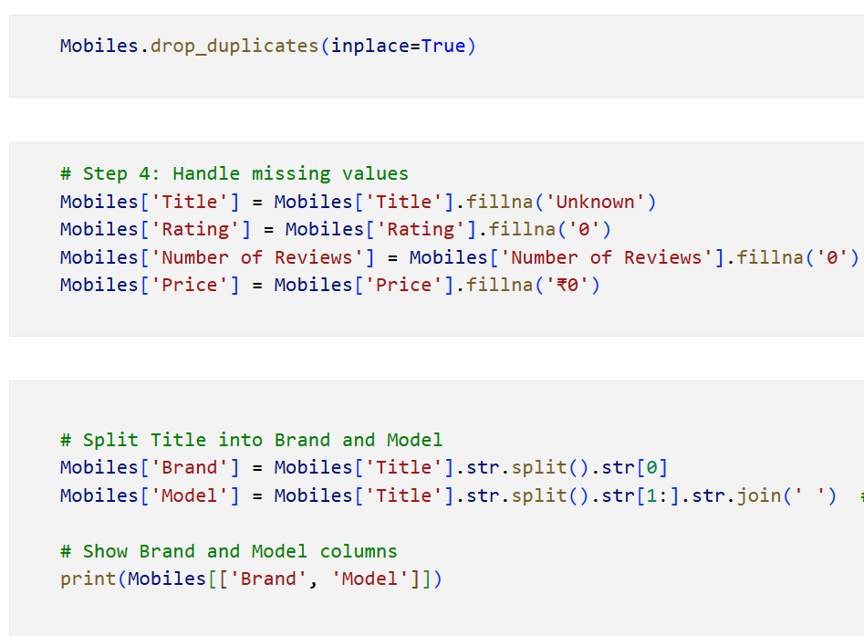
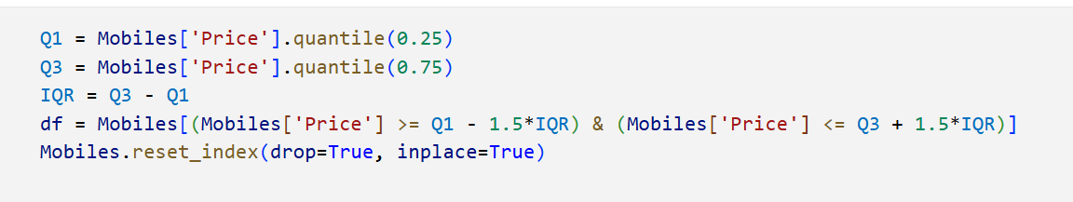
Data Cleaning :
Initial Cleanup: Removed duplicates and handled missing values.
Feature Engineering: Extracted Brand and Model names.
Data Transformation: Converted Price, Rating, and Review Count to clean numerical types.
Quality Control: Applied IQR method to handle Price outliers.

Slide 6
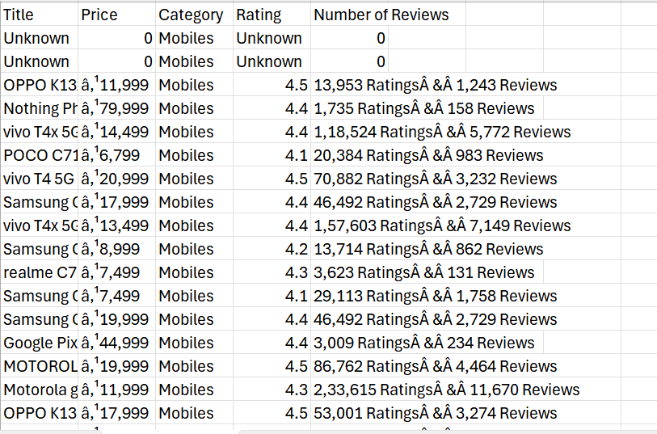
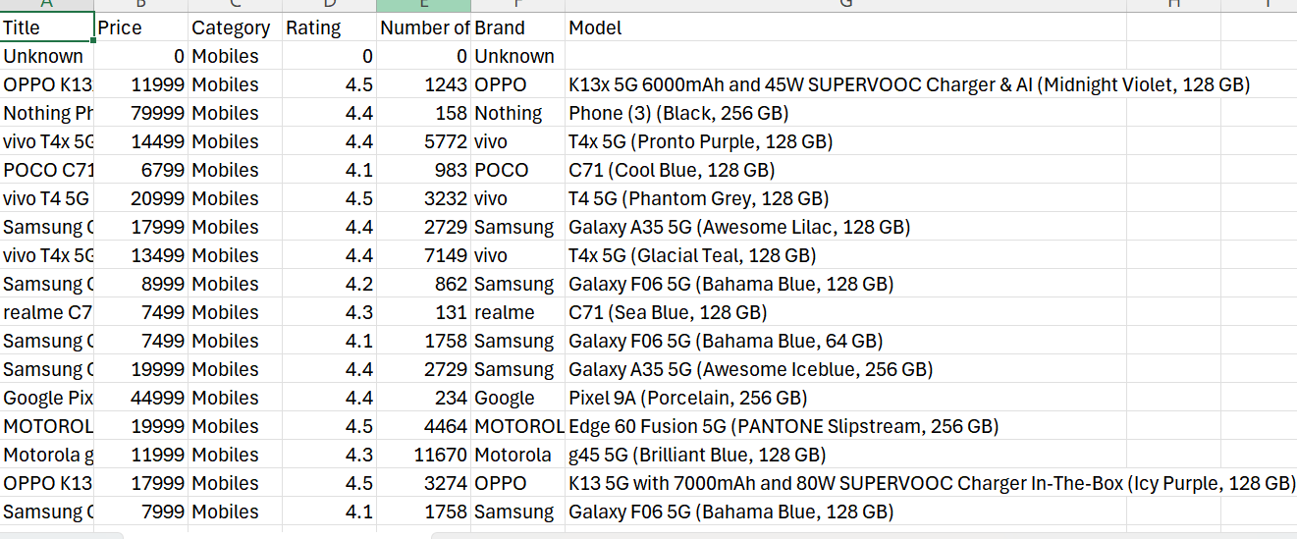
Data Cleaning :
After :
Before :

Slide 7
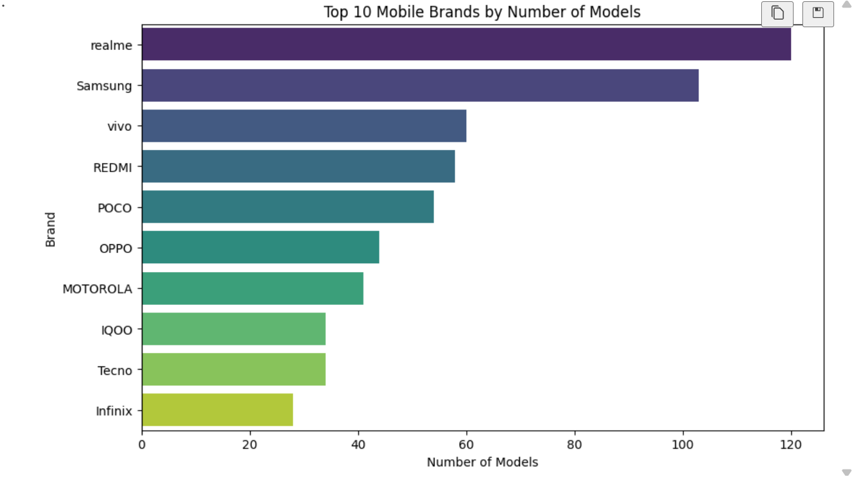
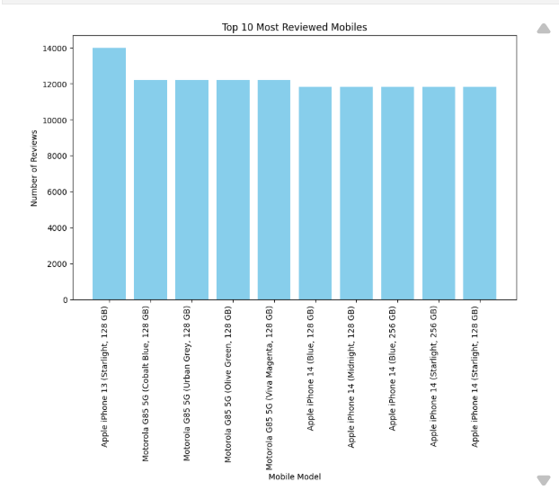
Exploratory Data Analysis :
Objective: Understand the market structure, pricing behavior, and customer response using cleaned data.

Slide 8
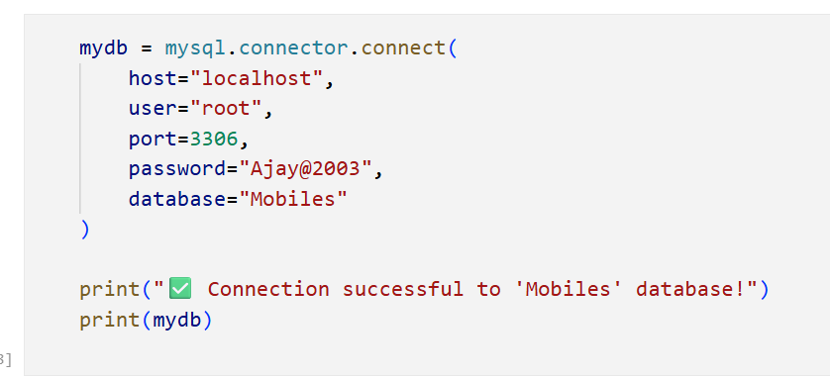
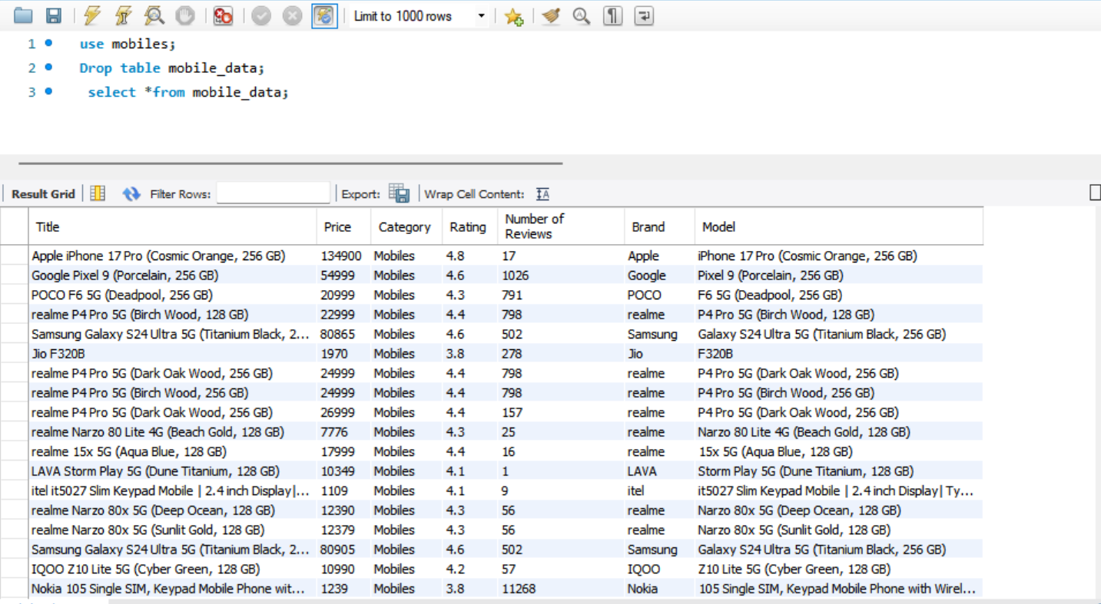
SQL Connectivity :
The SQLAlchemy (ORM) tool is used to move the final, cleaned DataFrame into a central SQL database.
This ensures data persistence and provides a scalable source of truth for all subsequent organizational data access.

Slide 9
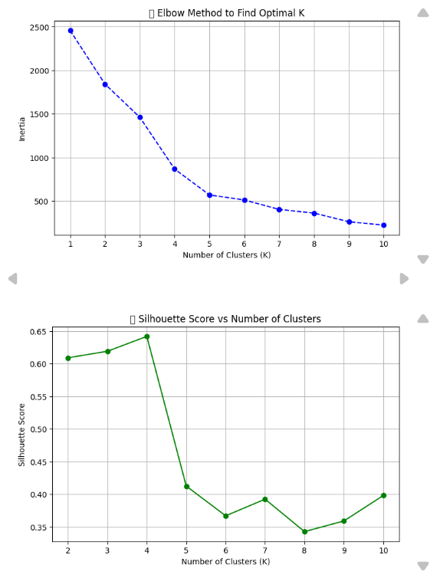
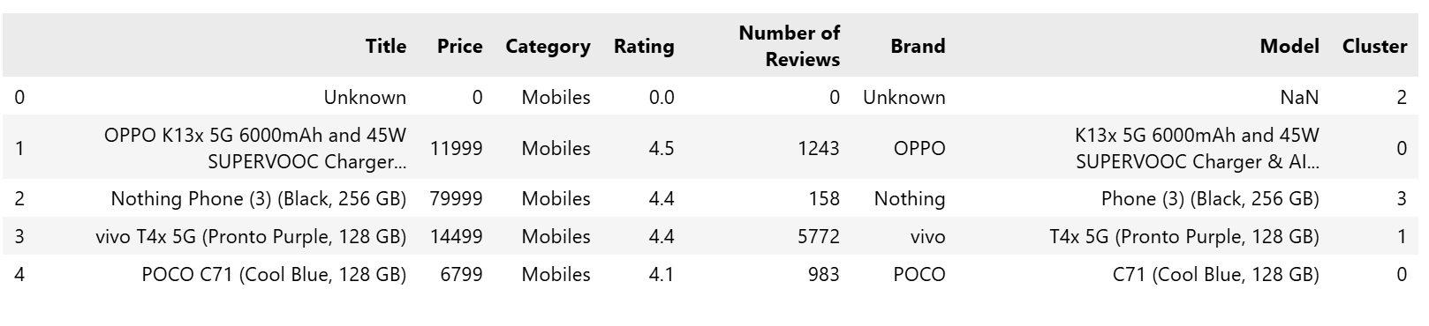
Unsupervised Learning :
K-Means Clustering
Goal: Group mobiles by Price, Rating, and Reviews. Algorithm: K-Means – finds natural clusters without labels. Optimal K: 4 clusters (via Silhouette Score). Insights:
Targeted marketing
Better product positioning
Competitive strategy

Slide 10
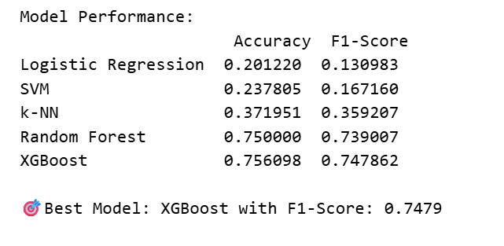
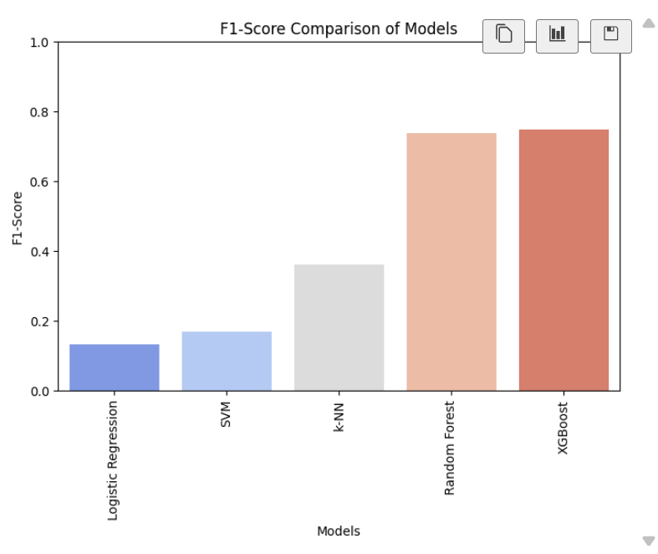
Supervised Learning :
Job: Classification—The model predicts which Brand a phone belongs to price and review.
Data Used: Phone Price and Number of Reviews.
Algorithms: Tested 5 models like Random Forest , XGBoost , SVM, K-NN and Logistic Regression.
Best Result: The XGBoost was selected as the Best Model, based on the highest F1-Score.

Slide 11
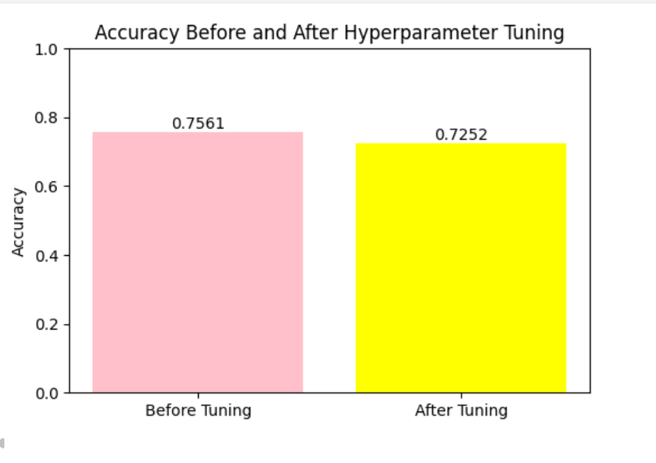
Hyperparameter Tuning: Grid Search
Goal: Optimize the Random Forest Classifier to maximize its Accuracy in predicting the phone brand.
Method: Used GridSearchCV to test combinations of parameters like max_depth and n_estimators.
Result: Identified the best parameters, resulting in a significant improvement in performance:
Accuracy Before Tuning: [0.7561]
Accuracy After Tuning (Best Score): [0.7252]

Slide 12
Conclusion & Future Work :
Success: Completed the full pipeline, from Web Scraping to an optimized Brand Classification Model.
Key Finding: Market is dominated by specific brands and mid-range pricing.
Future: Integrate more product specs (RAM/Processor) and explore Time Series Analysis.

Slide 13
Thank you & Any Question:

